Slide 1
Annual
Combustion Adjustment
Electronic Reporting
New Jersey Department of Environmental Protection

Slide 2
Who Needs to do Combustion Adjustment?
Boilers & Heaters
5 million Btu/hr or greater

Slide 3
What Air Contaminants?
NOx
CO

Slide 4
Combustion Adjustment Schedule
>20 MMBtu/hr
Already required
>10 MMBtu/hr but <20 MMBtu/hr
Already required
>5MMBtu/hr but <10 MMBtu/hr
2010

Slide 5
Online Submittal Schedule
>20 MMBtu/hr
2009
>10 MMBtu/hr but <20 MMBtu/hr
2010
>5 MMBtu/hr but <10 MMBtu/hr
2012

Slide 6
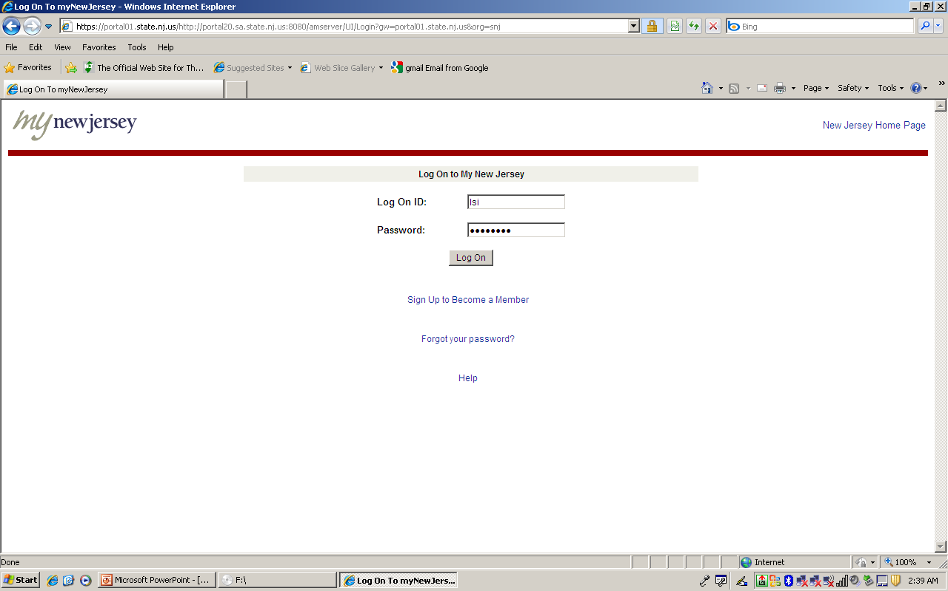

Slide 7
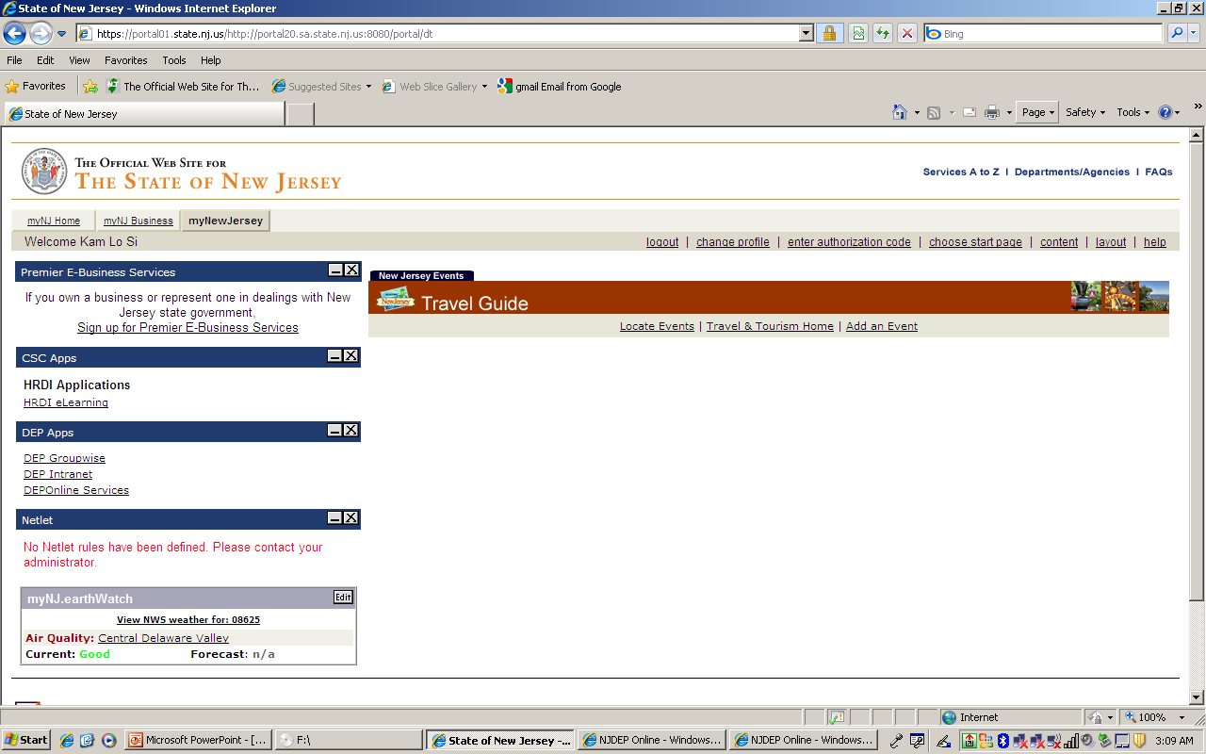

Slide 8
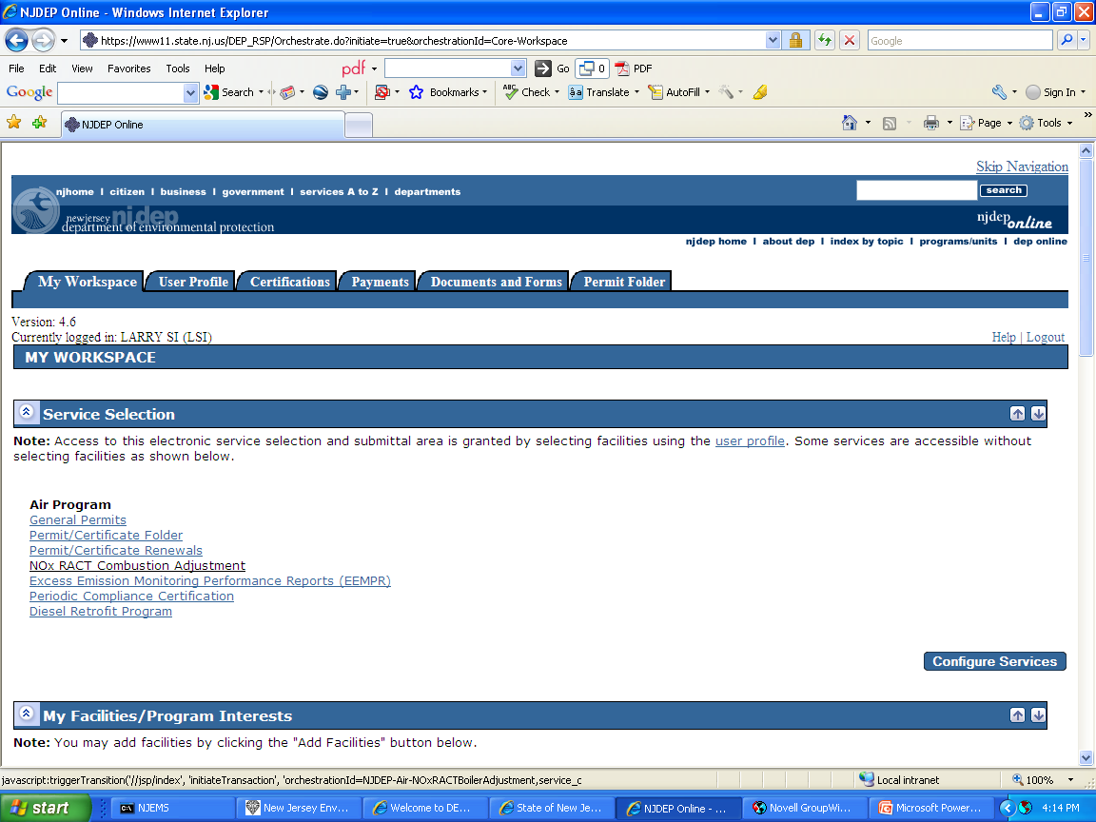

Slide 9
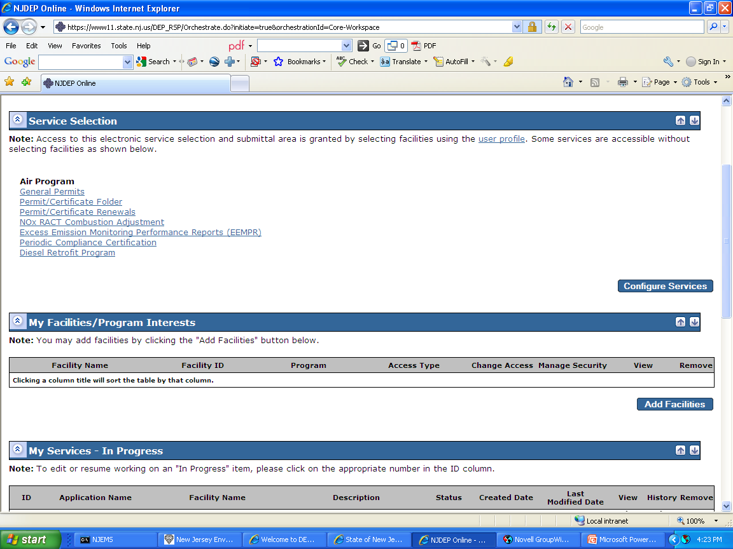

Slide 10
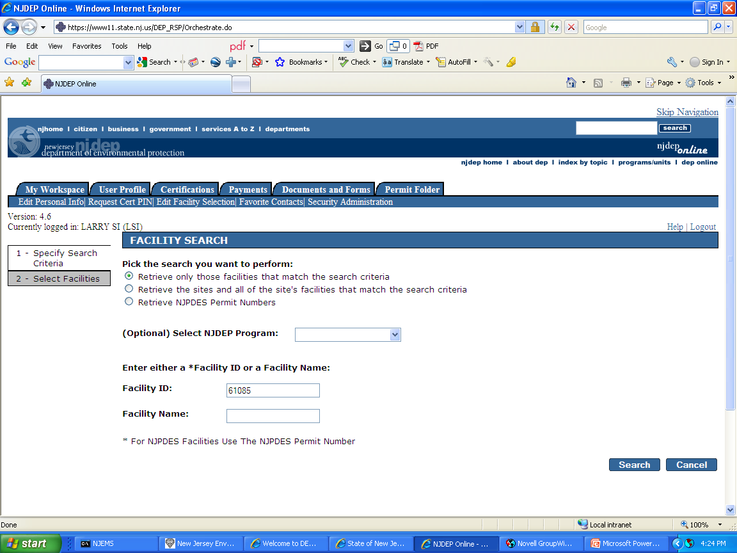

Slide 11
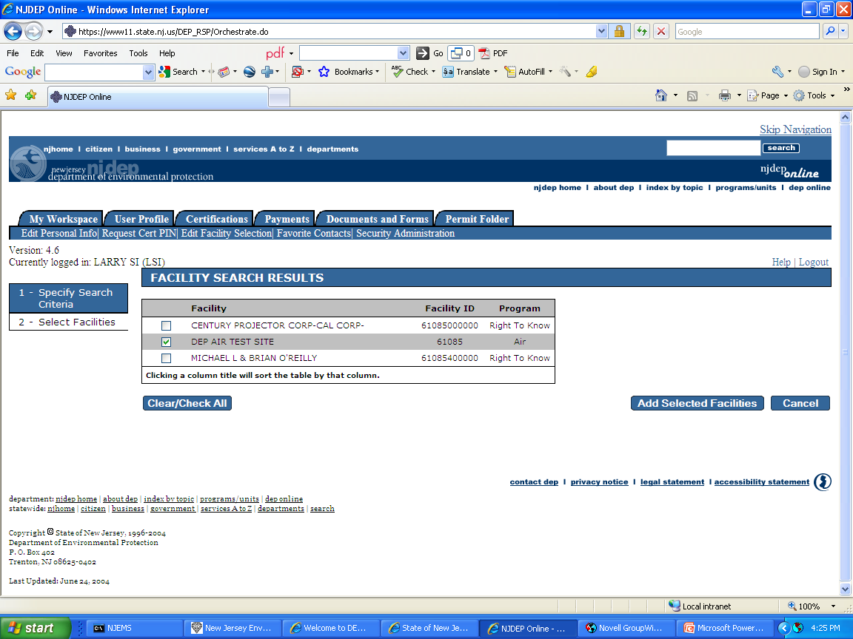

Slide 12
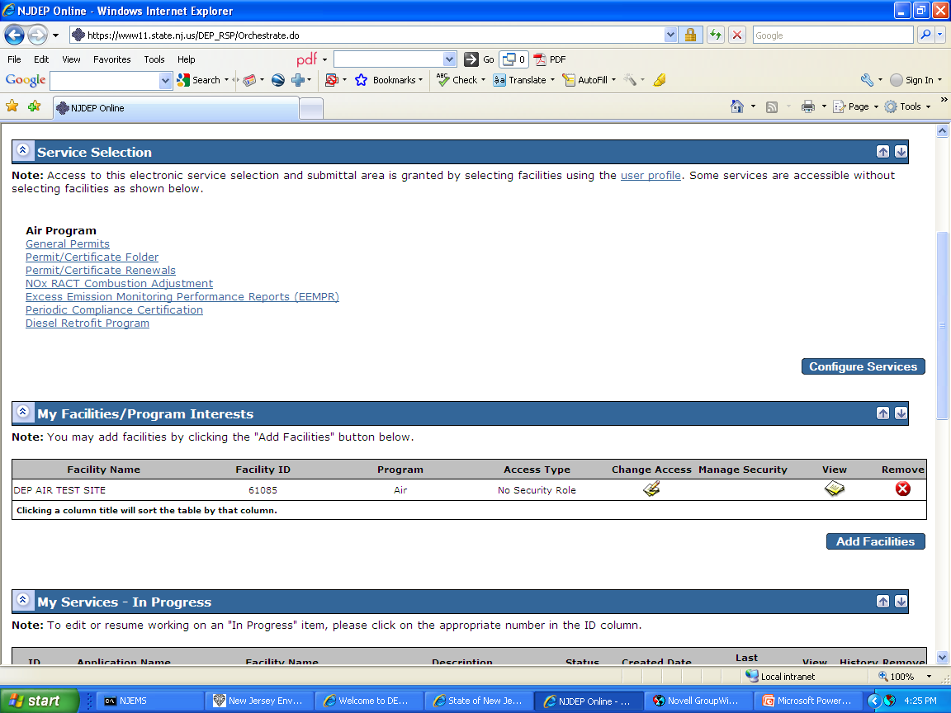

Slide 13
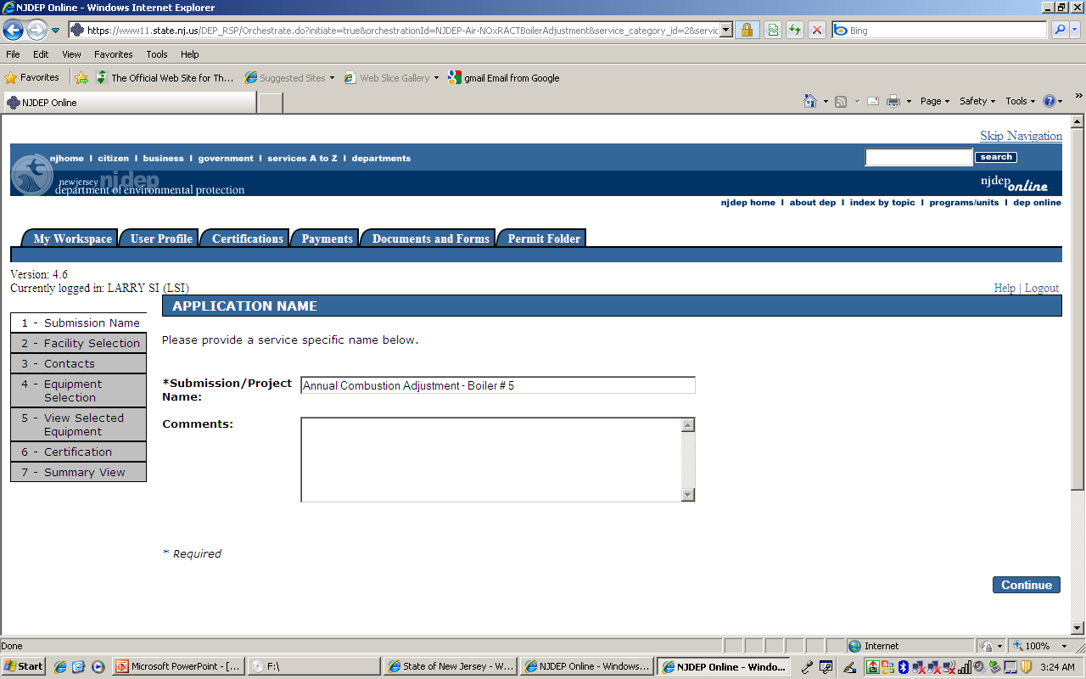

Slide 14
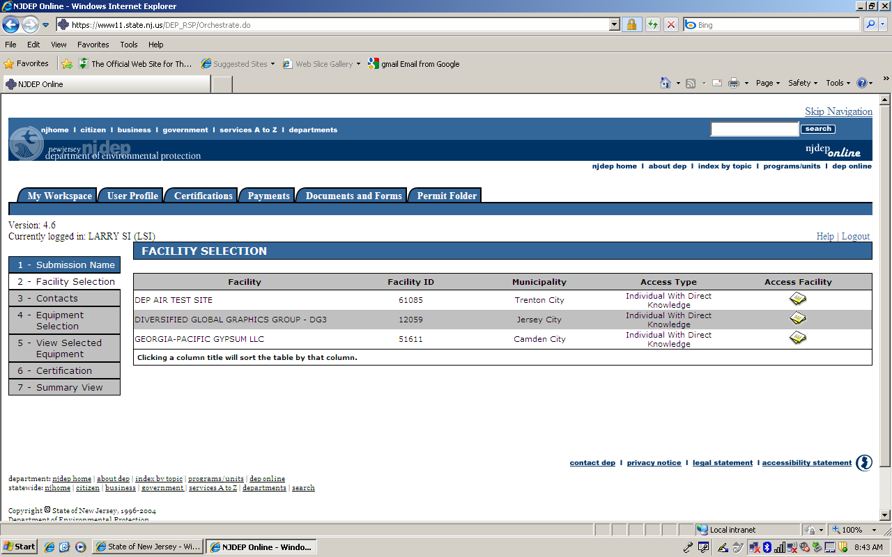

Slide 15
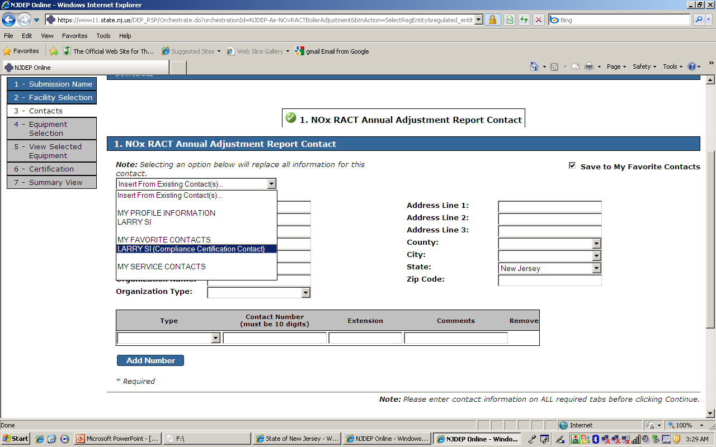

Slide 16
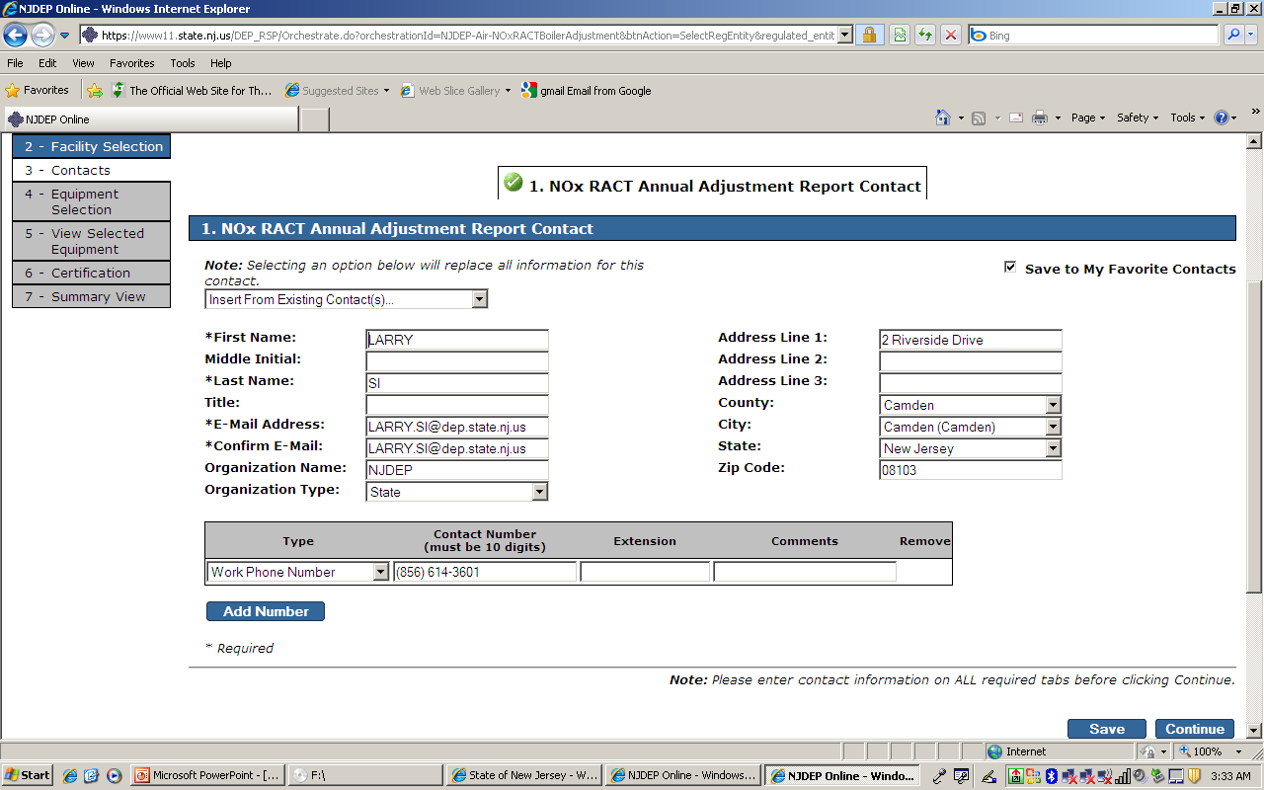

Slide 17
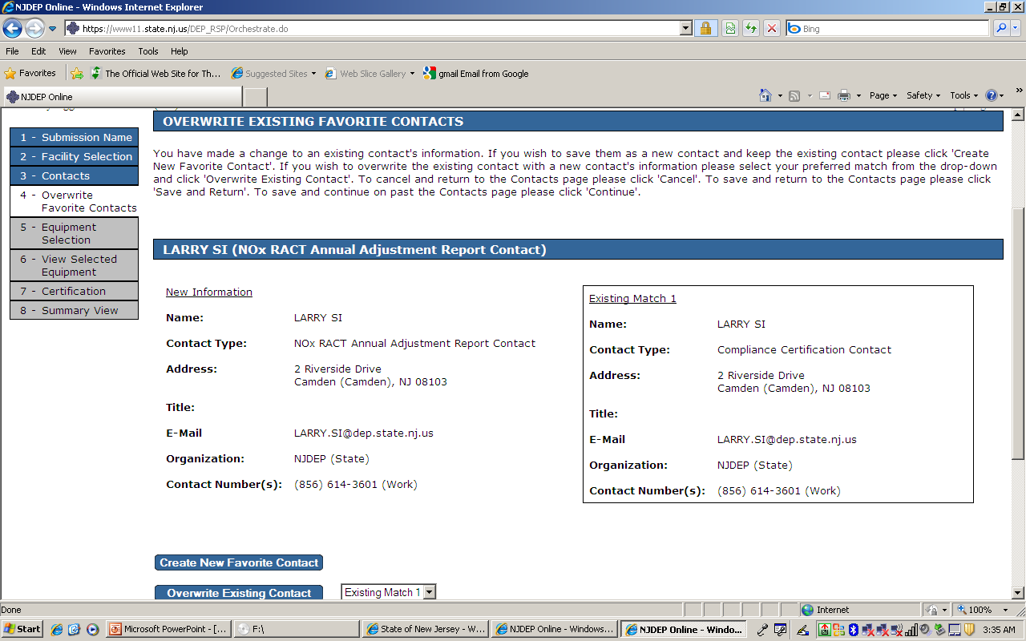

Slide 18
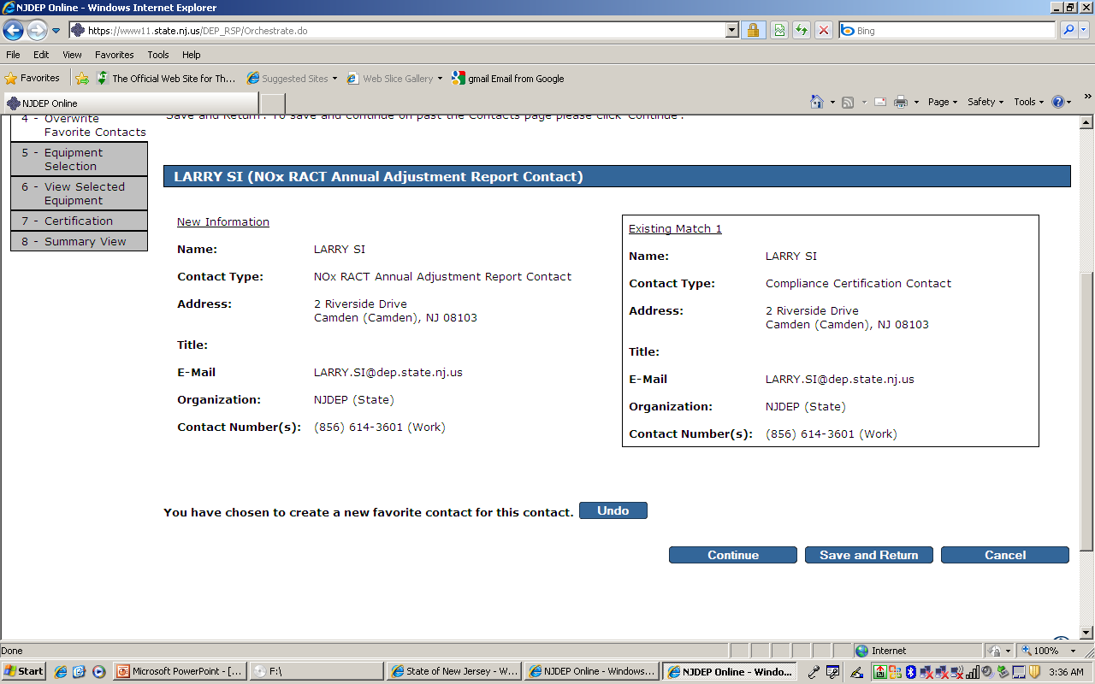

Slide 19
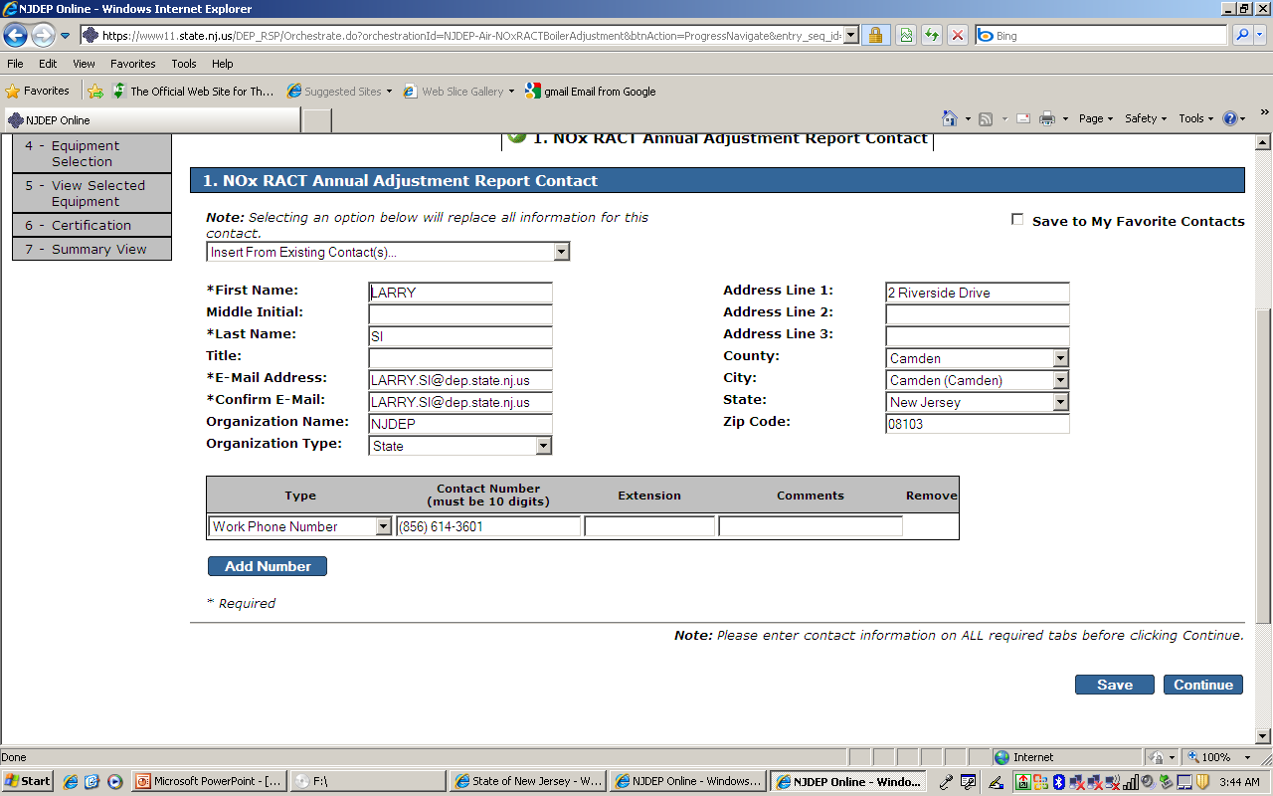

Slide 20
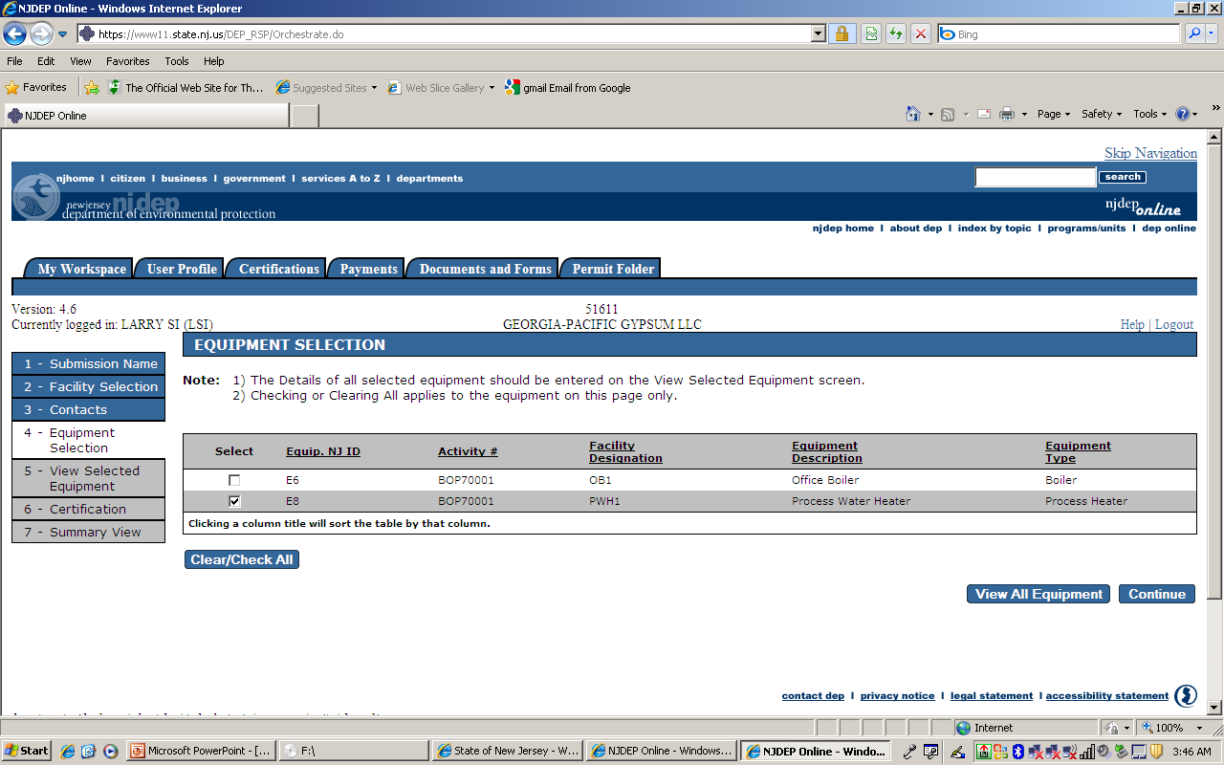

Slide 21
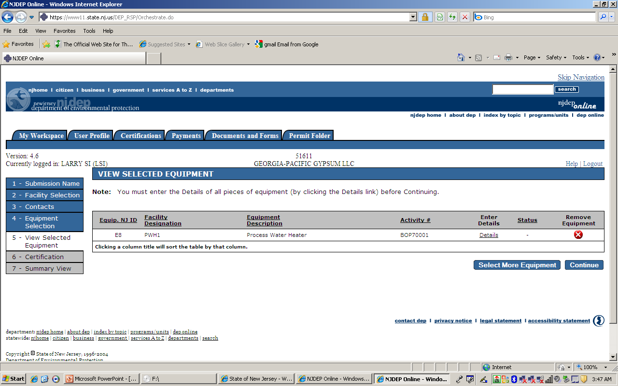

Slide 22
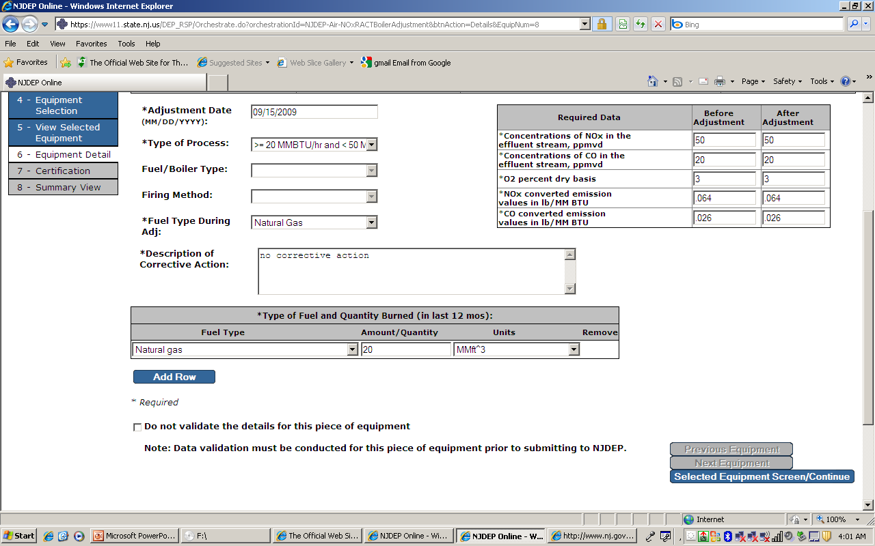

Slide 23


Slide 24
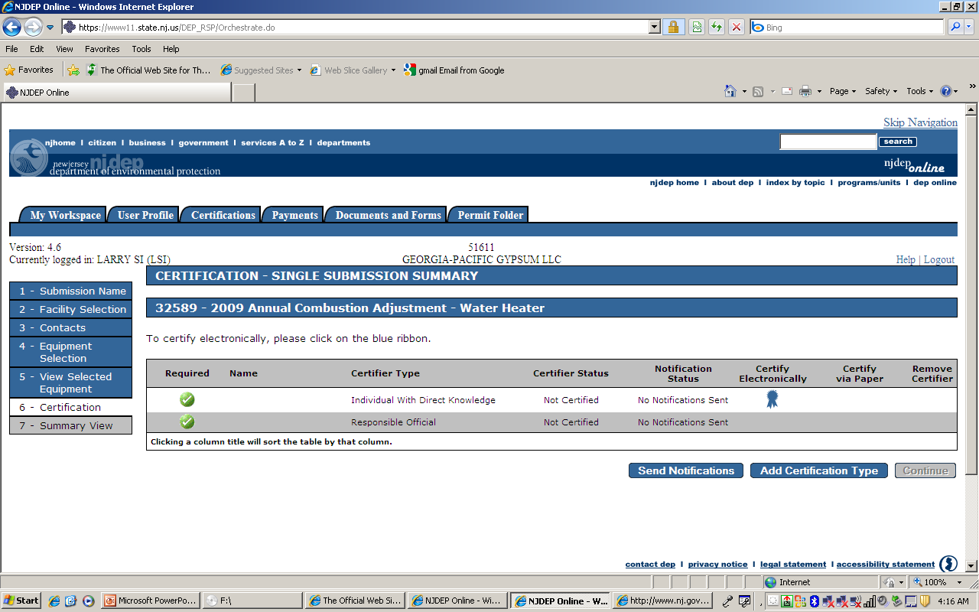

Slide 25
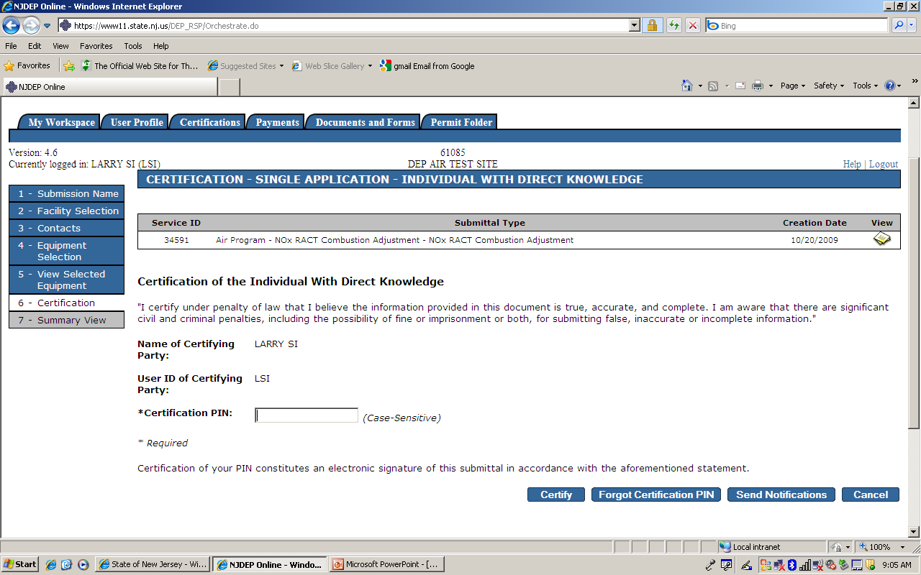

Slide 26
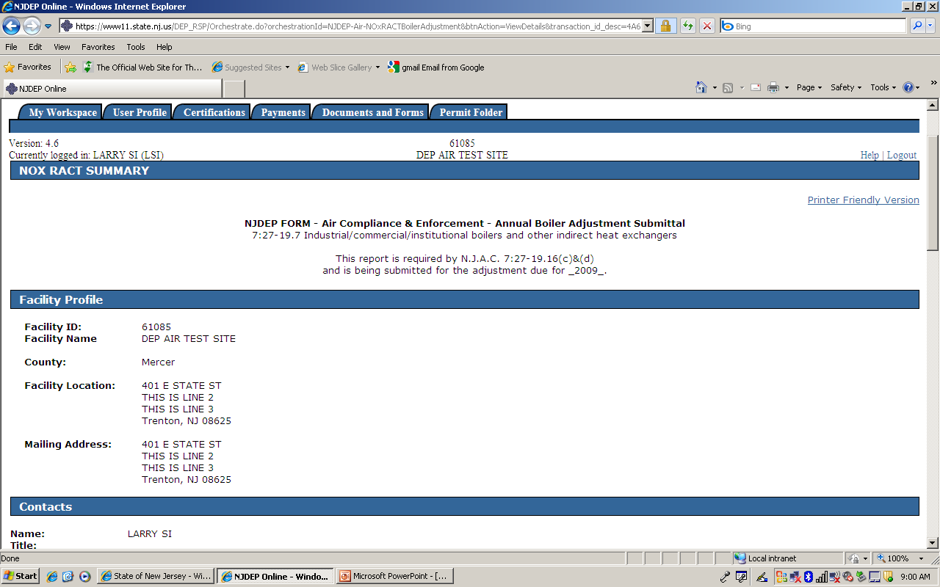

Slide 27
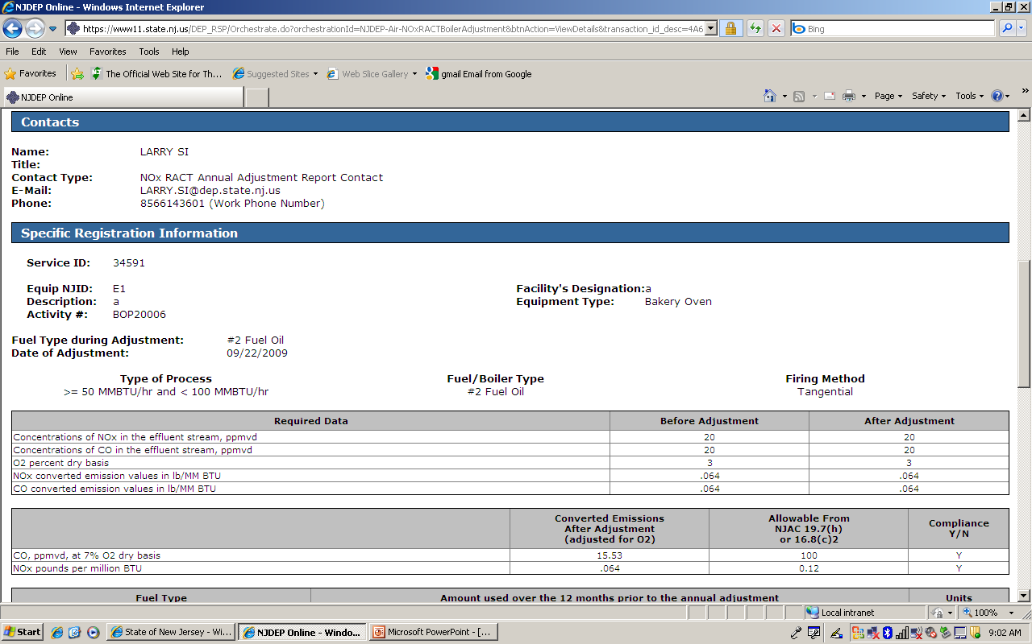

Slide 28
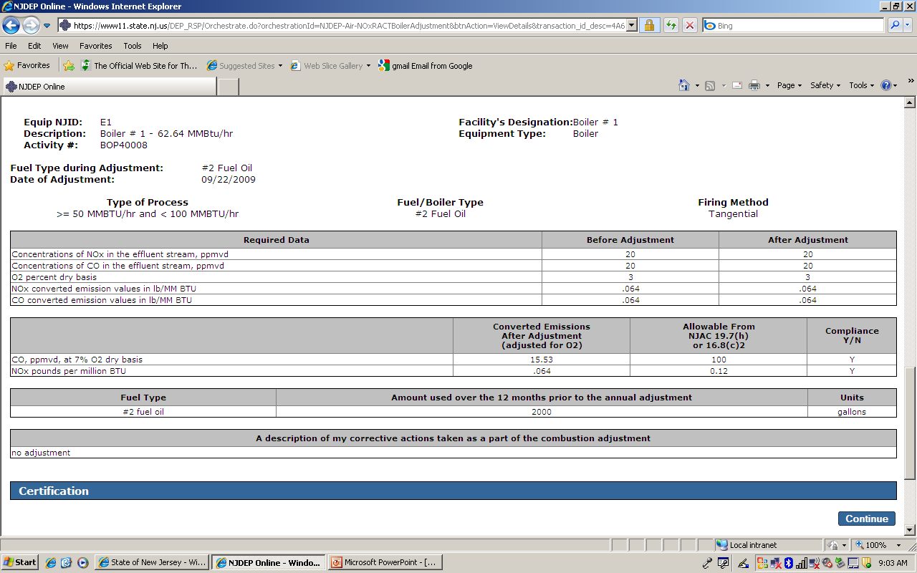

Slide 29
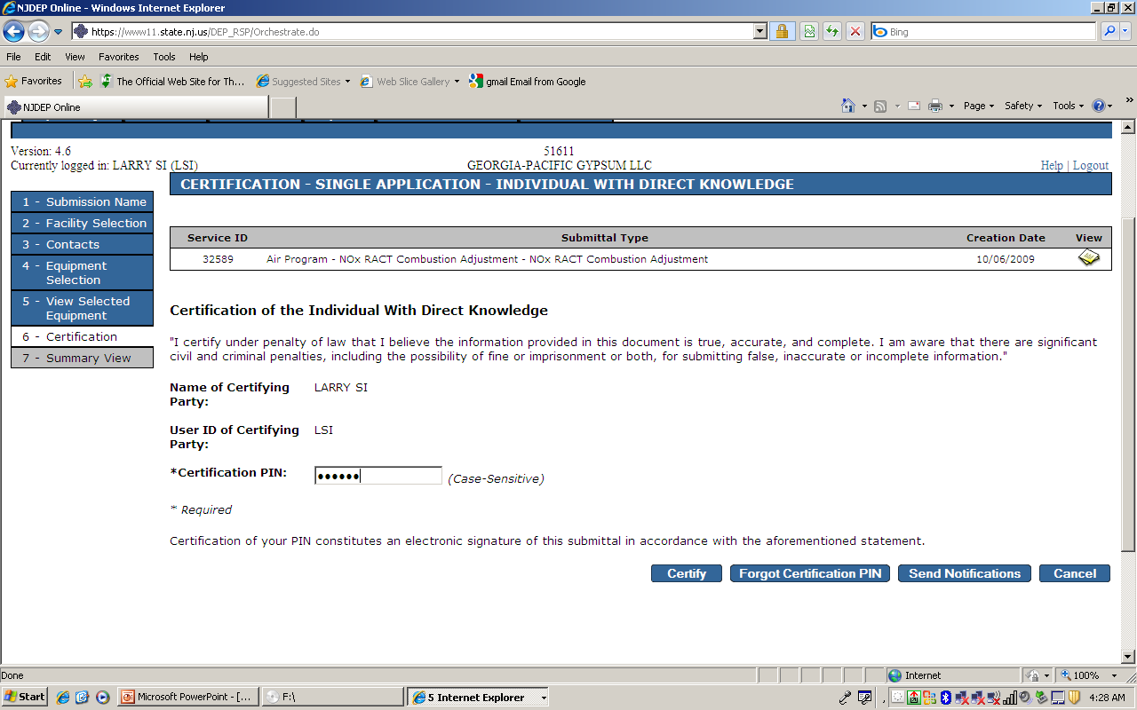

Slide 30


Slide 31
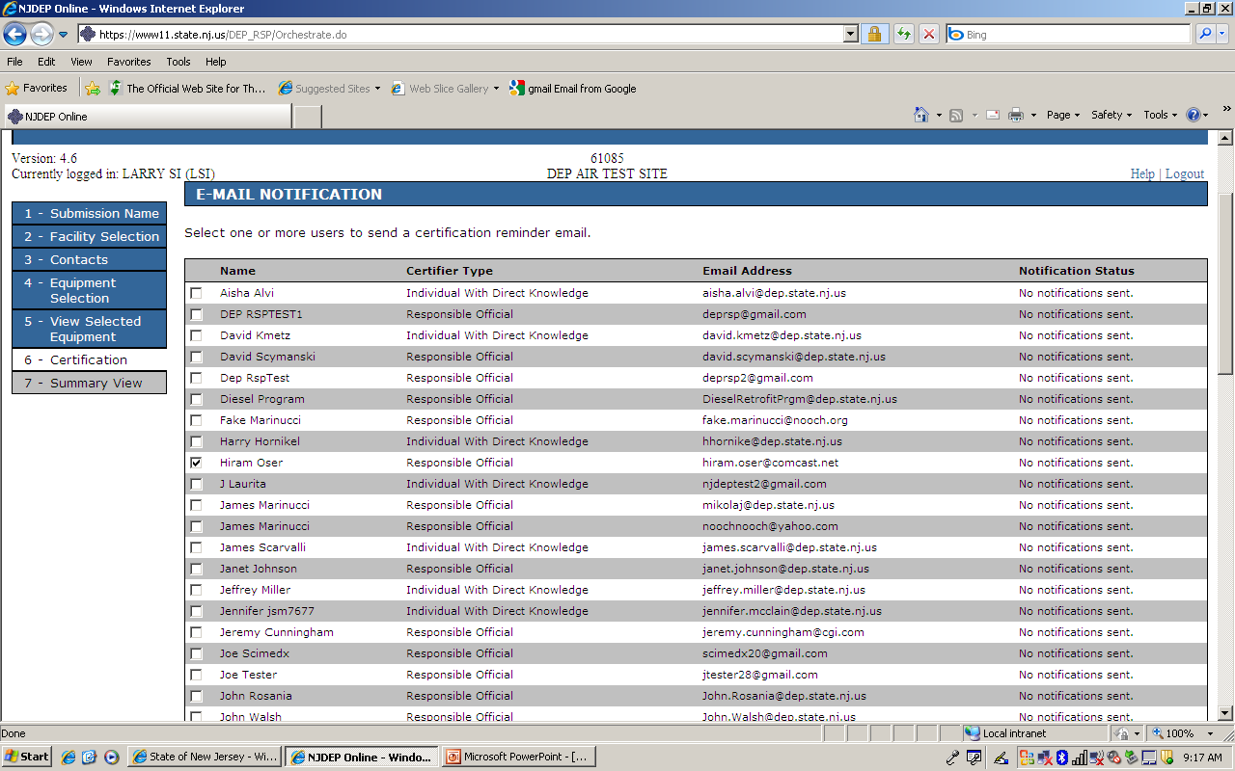

Slide 32
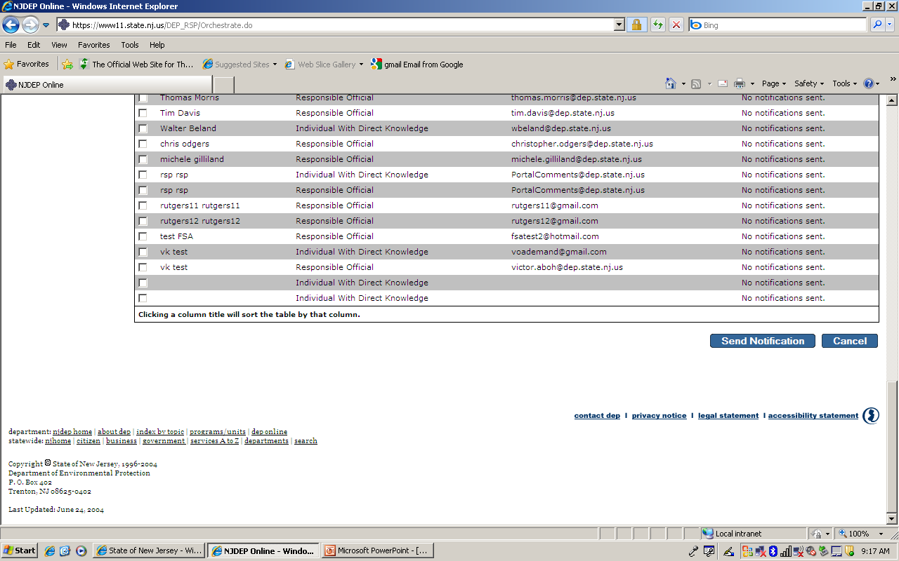

Slide 33
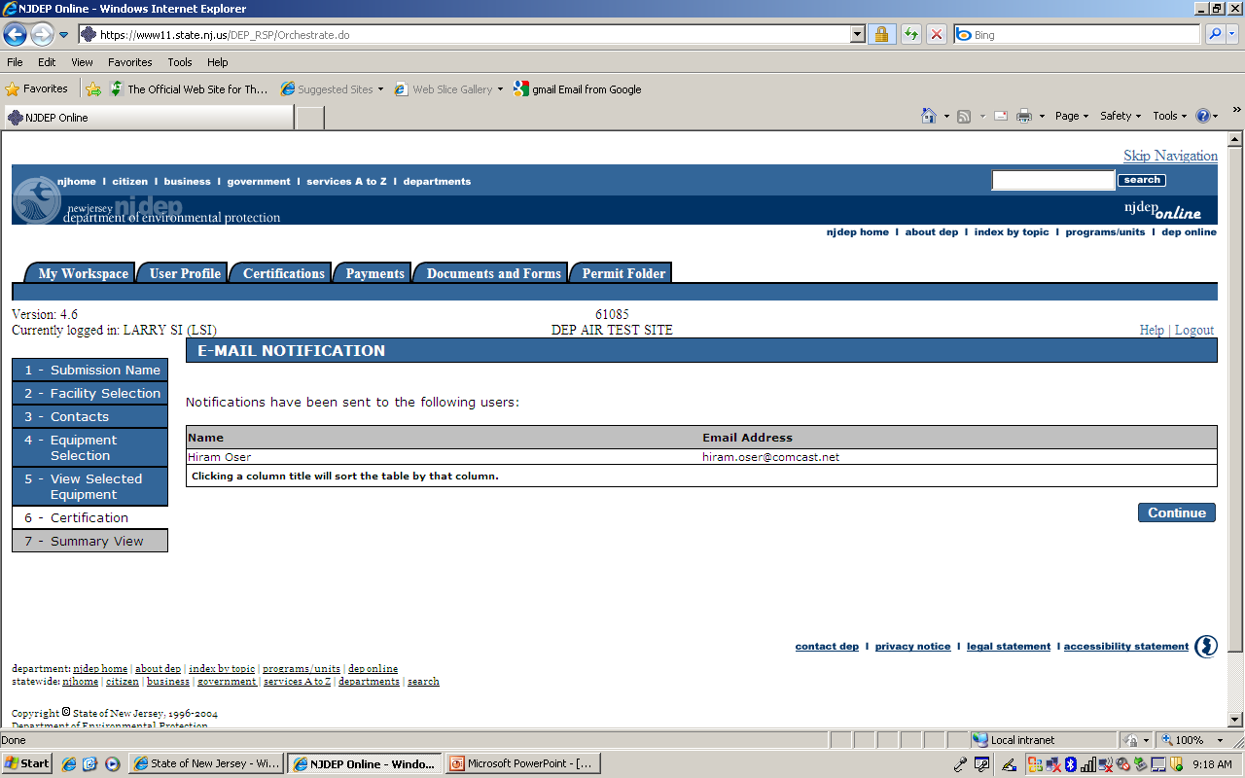

Slide 34
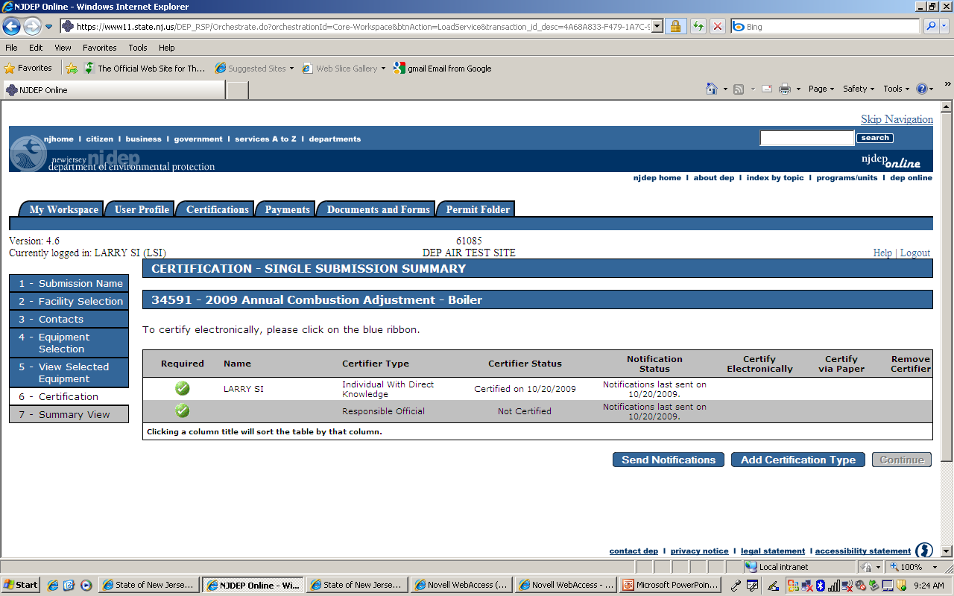

Slide 35
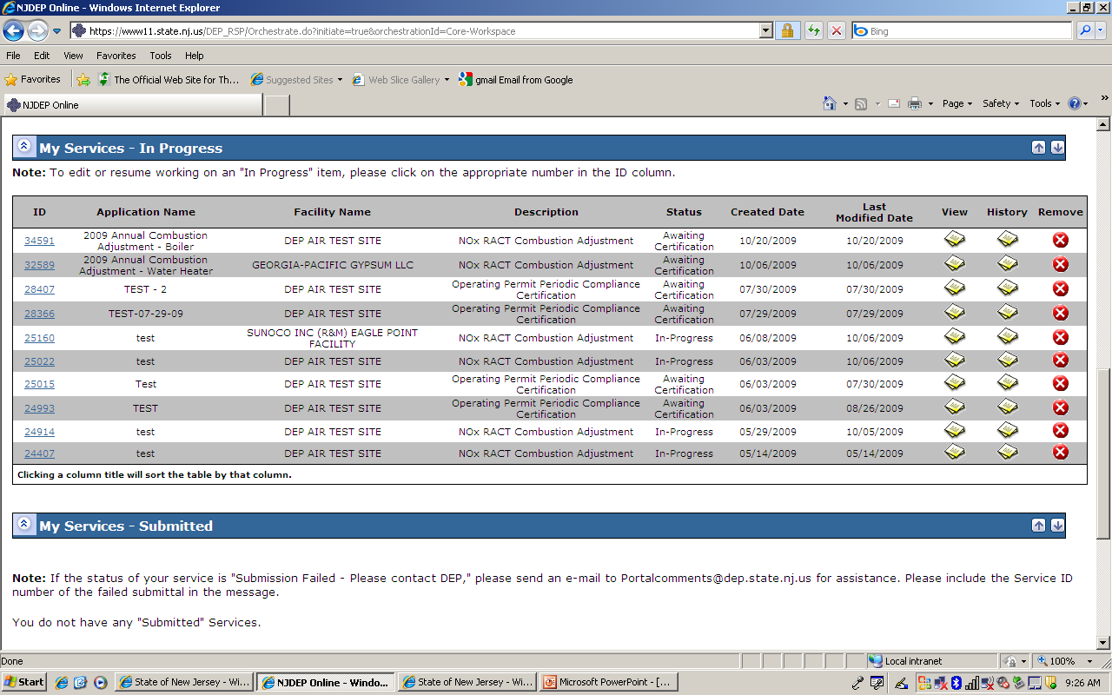

Slide 36
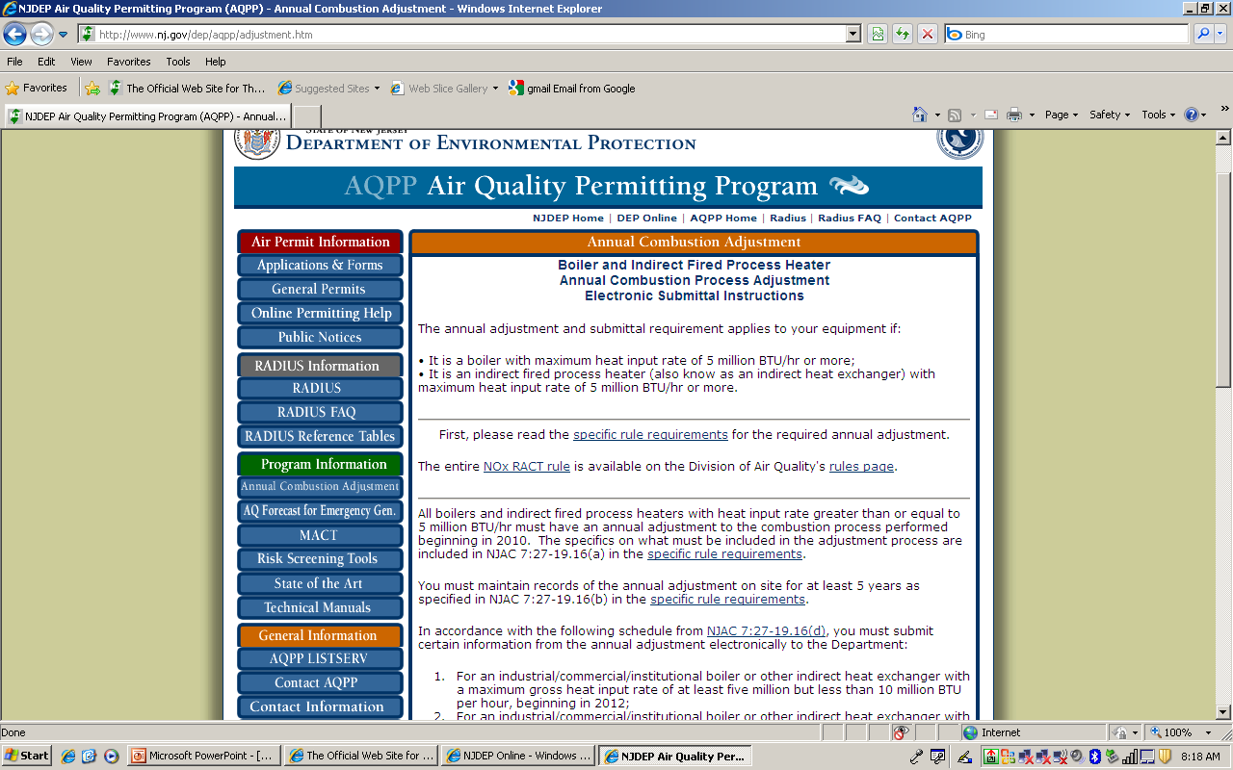

Slide 37
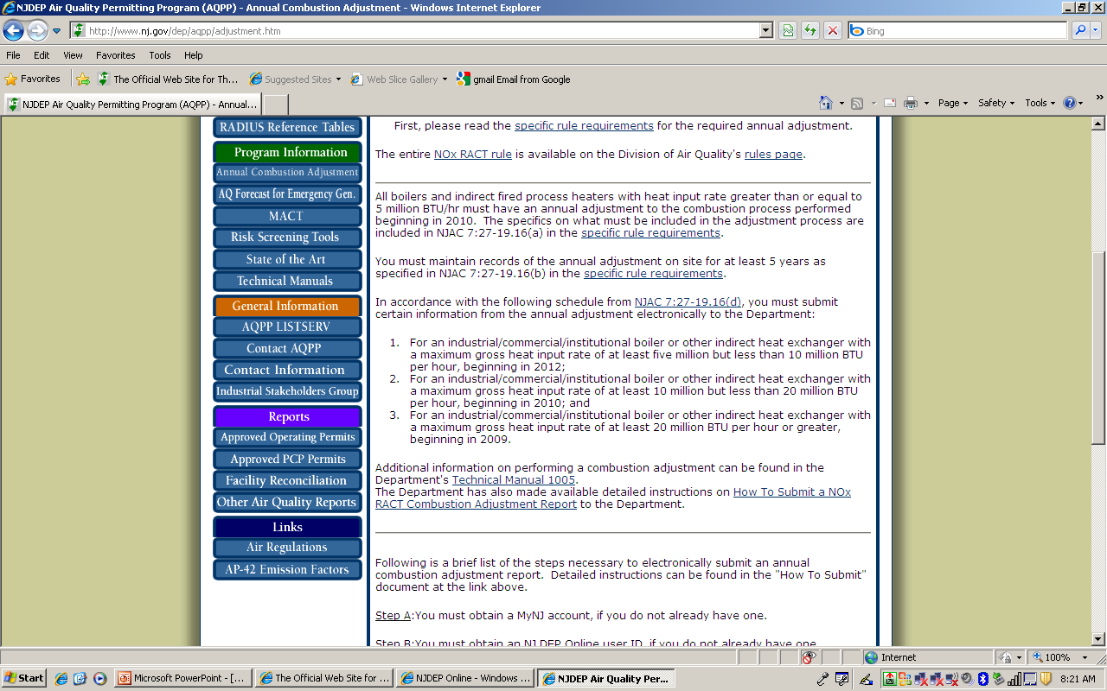

Slide 38
Central Region
  Telephone : 609-292-3187; Fax Number: 609-292-6450
  (Jurisdiction: Counties of Burlington, Mercer, Middlesex, Monmouth and Ocean)
Northern Region
  Telephone: 973-656-4444; Fax Number: 973-656-4080
  (Jurisdiction: Counties of Bergen, Essex, Hudson, Hunterdon, Morris, Passaic, Somerset, Sussex, Union and Warren)
Southern Region
  Telephone: 856-614-3601; Fax Number: 856-614-3613
  (Jurisdiction: Counties of Atlantic, Camden, Cape May, Cumberland, Gloucester, and Salem)

